Slide 1
Approximation Algorithms
Is Close Enough Good Enough?
Complexity
©D Moshkovitz

Slide 2
Motivation
By now we’ve seen many NP-Complete problems.
We conjecture none of them has polynomial time algorithm.
Complexity
©D Moshkovitz

Slide 3

Motivation
Is this a dead-end? Should we give up altogether?
?
Complexity
©D Moshkovitz

Slide 4

Motivation
Or maybe we can settle for good approximation algorithms?
Complexity
©D Moshkovitz

Slide 5
Introduction
Objectives:
  To formalize the notion of approximation.
  To demonstrate several such algorithms.
Overview:
  Optimization and Approximation
  VERTEX-COVER, SET-COVER
Complexity
©D Moshkovitz

Slide 6

Optimization
Many of the problems we’ve encountered so far are really optimization problems.
I.e - the task can be naturally rephrased as finding a maximal/minimal solution.
For example: finding a maximal clique in a graph.
Complexity
©D Moshkovitz

Slide 7
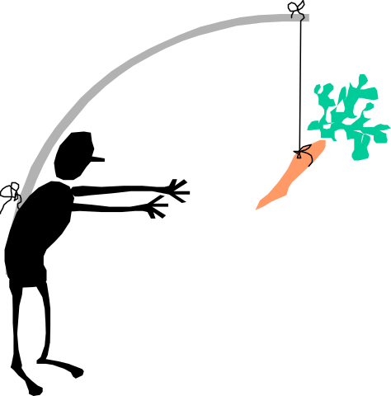
Approximation
An algorithm that returns an answer C which is “close” to the optimal solution C* is called an approximation algorithm.
“Closeness” is usually measured by the ratio bound ρ(n) the algorithm produces.
Which is a function that satisfies, for any input size n, max{C/C*,C*/C}≤ρ(n).
Complexity
©D Moshkovitz

Slide 8

Network Power
Say you have a network, with links between some components
Each link requires power supply, hence, you need to supply power to a set of nodes that cover all links
Obviously, you’d like to connect the smallest number of nodes
Complexity
©D Moshkovitz

Slide 9
VERTEX-COVER
Instance: an undirected graph G=(V,E).
Problem: find a set C⊆V of minimal size s.t. for any (u,v)∈E, either u∈C or v∈C.
Example:
Complexity
©D Moshkovitz

Slide 10
Minimum VC NP-hard
Proof: It is enough to show the decision problem below is NP-Complete:
Instance: an undirected graph G=(V,E) and a number k.
Problem: to decide if there exists a set V’⊆V of size k s.t for any (u,v)∈E, u∈V’ or v∈V’.
This follows immediately from the following observation.
Complexity
©D Moshkovitz

Slide 11
Minimum VC NP-hard
Observation: Let G=(V,E) be an undirected graph. The complement V\C of a vertex-cover C is an independent-set of G.
Proof: Two vertices outside a vertex-cover cannot be connected by an edge. 
Complexity
©D Moshkovitz

Slide 12
VC - Approximation Algorithm
COR(B) 523-524
C ← φ
E’ ← E
while E’ ≠ φ
  do let (u,v) be an arbitrary edge of E’
  C ← C ∪ {u,v}
  remove from E’ every edge incident to either u or v.
return C.
Complexity
©D Moshkovitz

Slide 13
Demo
Compare this cover to the one from the example
Complexity
©D Moshkovitz

Slide 14
Polynomial Time
C ← φ
E’ ← E
while E’ ≠ φ do
  let (u,v) be an arbitrary edge of E’
  C ← C ∪ {u,v}
  remove from E’ every edge incident to either u or v
return C
O(n²)
O(1)
O(n²)
O(n)
Complexity
©D Moshkovitz

Slide 15

Correctness
The set of vertices our algorithm returns is clearly a vertex-cover, since we iterate until every edge is covered.
Complexity
©D Moshkovitz

Slide 16
How Good an Approximation is it?
Observe the set of edges our algorithm chooses
no common vertices!
⇒ any VC contains 1 in each
our VC contains both, hence at most twice as large
Complexity
©D Moshkovitz

Slide 17

Mass Mailing
Say you’d like to send some message to a large list of people (e.g. all campus)
There are some available mailing-lists, however, the moderator of each list charges $1 for each message sent
You’d like to find the smallest set of lists that covers all recipients
Complexity
©D Moshkovitz

Slide 18
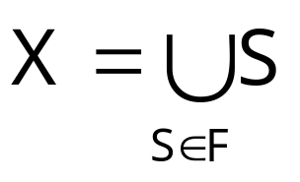
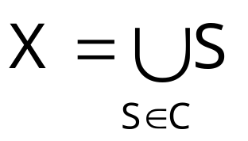
SET-COVER
Instance: a finite set X and a family F of subsets of X, such that
Problem: to find a set C⊆F of minimal size which covers X, i.e -
Complexity
©D Moshkovitz

Slide 19
SET-COVER: Example
Complexity
©D Moshkovitz

Slide 20

SET-COVER is NP-Hard
Proof: Observe the corresponding decision problem.
Clearly, it’s in NP (Check!).
We’ll sketch a reduction from (decision) VERTEX-COVER to it:
Complexity
©D Moshkovitz

Slide 21
VERTEX-COVER ≤_{p} SET-COVER
one element for every edge
VC
VC
SC
one set for every vertex, containing the edges it covers
Complexity
©D Moshkovitz

Slide 22

The Greedy Algorithm
COR(B) 530-533
C ← φ
U ← X
while U ≠ φ do
  select S∈F that maximizes |S∩U|
  C ← C ∪ {S}
  U ← U - S
return C
min{|X|,|F|}
O(|F|·|X|)
Complexity
©D Moshkovitz

Slide 23
Demonstration
compare to the optimal cover
0
1
2
3
4
5
Complexity
©D Moshkovitz

Slide 24
Is Being Greedy Worthwhile? How Do We Proceed From Here?
We can easily bound the approximation ratio by logn.
A more careful analysis yields a tight bound of lnn.
Complexity
©D Moshkovitz

Slide 25
The Trick
We’d like to compare the number of subsets returned by the greedy algorithm to the optimal
The optimal is unknown, however, if it consists of k subsets, then any part of the universe can be covered by k subsets!
Which is exactly what the next 3 distinct arguments take advantage of
Complexity
©D Moshkovitz

Slide 26
Loose Ratio-Bound
Claim: If ∃ cover of size k, then after k iterations the algorithm have covered at least ½ of the elements
the n elements
Suppose it doesn’t and observe the situation after k iterations:
>½
already covered
Complexity
©D Moshkovitz

Slide 27
Loose Ratio-Bound
Claim: If ∃ cover of size k, then after k iterations the algorithm have covered at least ½ of the elements
Since this part → can also be covered by k sets...
the n elements
>½
already covered
Complexity
©D Moshkovitz

Slide 28
Loose Ratio-Bound
Claim: If ∃ cover of size k, then after k iterations the algorithm have covered at least ½ of the elements
the n elements
there must be a set not chosen yet, whose size is at least ½n·1/k
>½
already covered
Complexity
©D Moshkovitz

Slide 29
Loose Ratio-Bound
Claim: If ∃ cover of size k, then after k iterations the algorithm have covered at least ½ of the elements
and the claim is proven!
the n elements
>½
Thus in each of the k iterations we’ve covered at least ½n·1/k new elements
already covered
Complexity
©D Moshkovitz

Slide 30
Loose Ratio-Bound
Claim: If ∃ cover of size k, then after k iterations the algorithm covered at least ½ of the elements.
Therefore after klogn iterations (i.e - after choosing klogn sets) all the n elements must be covered, and the bound is proved.
Complexity
©D Moshkovitz

Slide 31
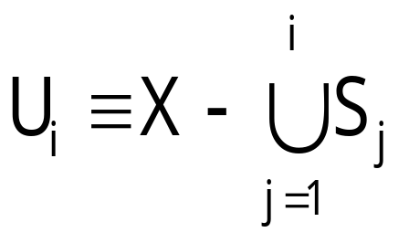
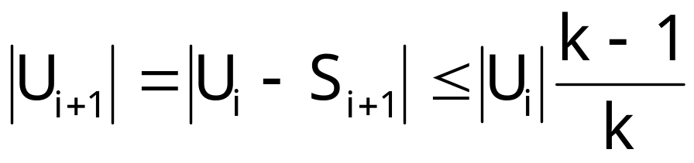
Better Ratio Bound
Let S₁, …, S_{t} be the sequence of sets outputted by the greedy algorithm. Let, for 0 ≤ i ≤ t
Since, for every i, U_{i} can be covered by k sets, it follows
Complexity
©D Moshkovitz

Slide 32
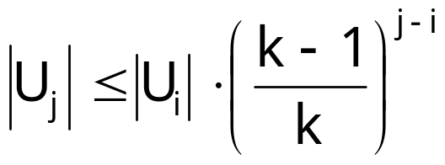
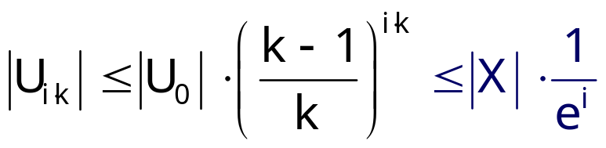
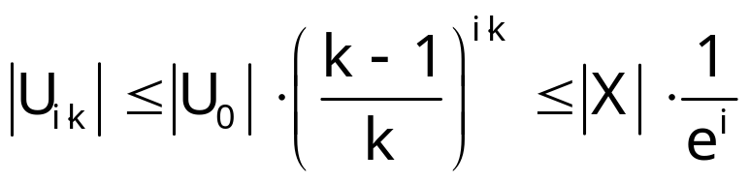
Better Ratio Bound
Hence, for any 0 ≤ i < j ≤ t
Which implies that for every i
Therefore, t ≤ k ln(n) + 1
Complexity
©D Moshkovitz

Slide 33
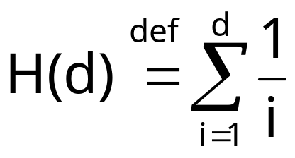
Tight Ratio-Bound
Claim: The greedy algorithm approximates the optimal set-cover to within a factor
H(max{ |S|: S∈F } )
Where H(d) is the d-th harmonic number:
Complexity
©D Moshkovitz

Slide 34
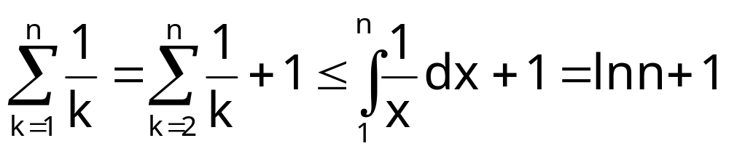
Tight Ratio-Bound
Complexity
©D Moshkovitz

Slide 35
Claim’s Proof
Charge $1 for each set
Split cost between covered elements
Bound from above the total fees paid
0.2
0.2
each recipient pays the fractional cost for the first mailing-list it appears in
0.2
0.2
0.2
Complexity
©D Moshkovitz

Slide 36
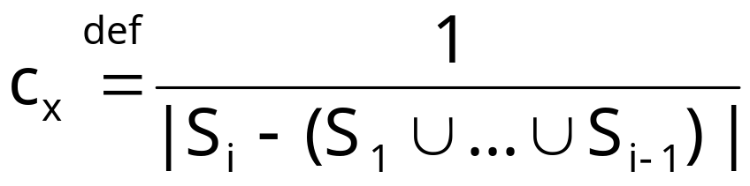
Analysis
Thus, every element x∈X is charged
Where S_{i} is the first set that covers x.
c_{x}
Complexity
©D Moshkovitz

Slide 37
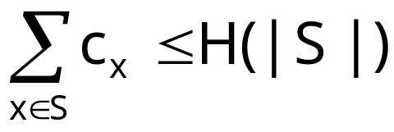
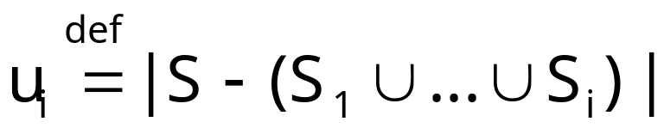
Lemma
number of members of S still uncovered after i iterations
Lemma: For every S∈F
Proof: Fix an S∈F. For any i, let
∀1≤i≤k : S_{i} covers u_{i-1}-u_{i} elements of S
Let k be the smallest index, s.t. u_{k}=0
Complexity
©D Moshkovitz

Slide 38
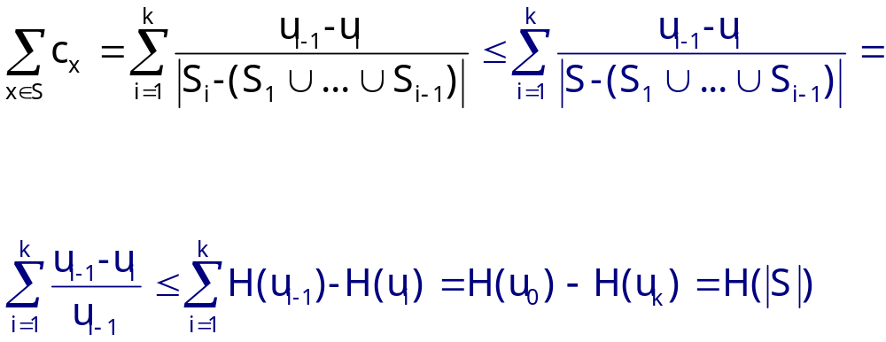
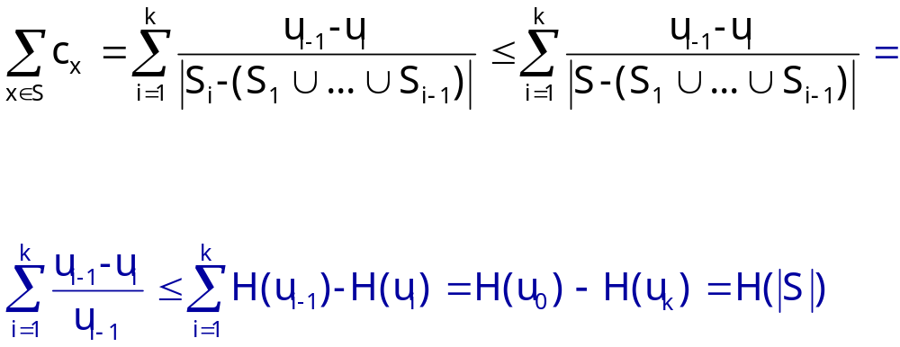
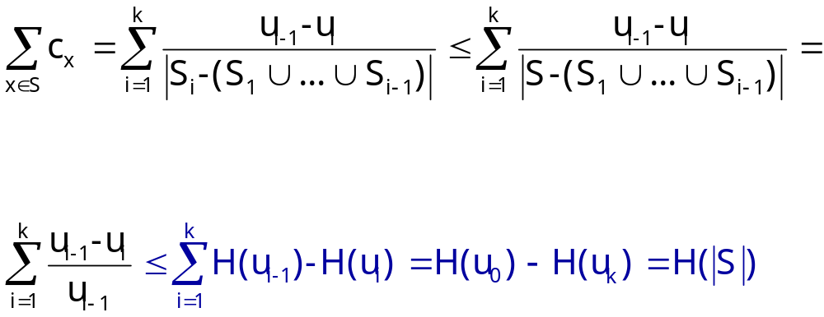
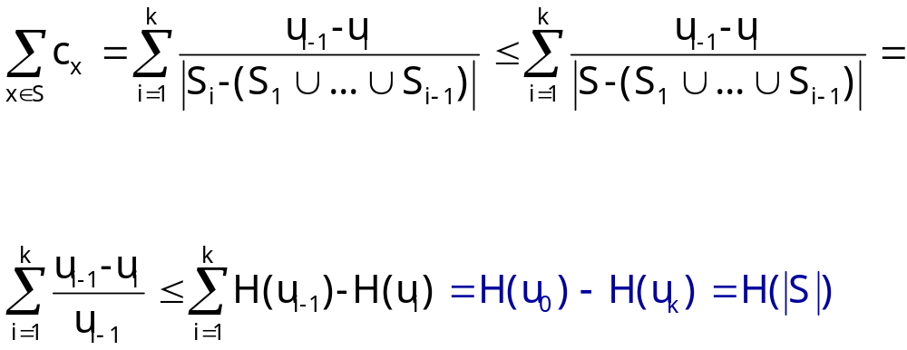
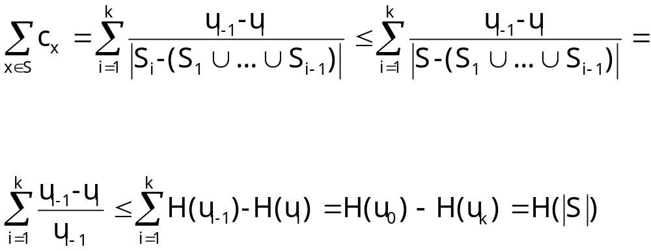
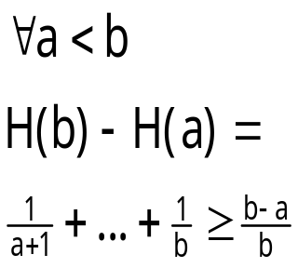
Lemma
sum charges
else greedy strategy would have taken S instead of S_{i}
definition of u_{i-1}
H(u_{k})=H(0)=0
H(u₀)=H(|S|)
Telescopic sum
Complexity
©D Moshkovitz

Slide 39
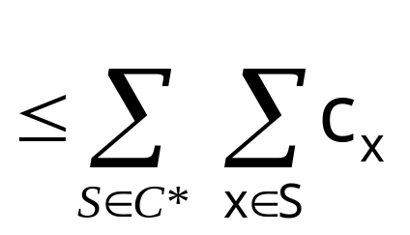
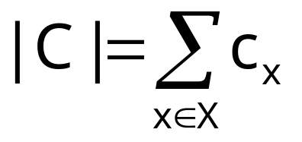
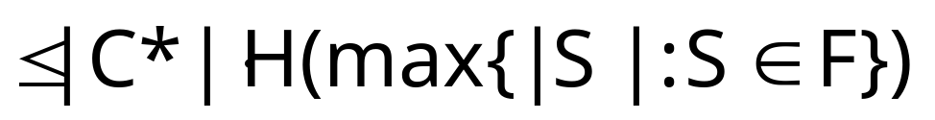
Analysis
Now we can finally complete our analysis:
Complexity
©D Moshkovitz

Slide 40
Summary
◉
As it turns out, we can sometimes find efficient approximation algorithms for NP-hard problems.
We’ve seen two such algorithms:
  for VERTEX-COVER (factor 2)
  for SET-COVER (logarithmic factor).
Complexity
©D Moshkovitz

Slide 41
What’s Next?
◉
But where can we draw the line?
Does every NP-hard problem have an approximation?
And to within which factor?
Can approximation be NP-hard as well?!
Complexity
©D Moshkovitz

